Slide 1


Ben Zoet
11/17/2025

Slide 2

Outline
Executive Summary
Introduction
Methodology
Results
Conclusion
Appendix

Slide 3
Executive Summary
I collected and cleaned SpaceX launch data to prepare a reliable dataset for analysis. Exploratory data analysis using visualizations and SQL revealed key patterns such as payload effects and site-specific performance. Interactive dashboards built with Folium and Plotly Dash enabled dynamic exploration of launch outcomes.
Multiple classification models were developed and tuned using GridSearchCV to predict landing success. Among all approaches, the Decision Tree model achieved the highest accuracy and delivered the most consistent predictive results.

Slide 4
Introduction
This project analyzes SpaceX launch data to understand the factors that influence rocket landing success. As reusable rocket technology becomes increasingly important for reducing launch costs, identifying these drivers has both operational and economic value. Through data exploration, visualization, and predictive modeling, we aim to uncover measurable patterns in payload, launch site, and booster characteristics. Ultimately, the goal is to predict landing outcomes and determine which modeling techniques provide the most reliable performance.

Slide 5

Section 1

Slide 6
Methodology
Executive Summary
Data collection methodology:
The dataset was sourced from publicly available SpaceX launch records using REST API and Web Scraping.
Perform data wrangling
Raw data was cleaned, standardized, and transformed to ensure consistency, resolve missing values, and create model-ready features.
Perform exploratory data analysis (EDA) using visualization and SQL
Perform interactive visual analytics using Folium and Plotly Dash
Perform predictive analysis using classification models
Logistic Regression, Support Vector Machines, Decision Trees, and K-Nearest Neighbors were trained and tuned using GridSearchCV, then evaluated on a separate test dataset to compare their final performance.

Slide 7
Data Collection
Using the SpaceX REST API, I performed GET requests to retrieve launch data in JSON format, converted it to a Pandas DataFrame, and cleaned missing values as part of that process. I also used web scraping with BeautifulSoup to extract launch data from the SpaceX Wikipedia page, cleaning the table rows and columns as they were parsed. Each dataset was prepared and validated at the point of collection, allowing me to calculate key metrics.
SpaceX REST API: Retrieved and cleaned JSON data → normalized into DataFrame
Web Scraping: Parsed and cleaned HTML tables using BeautifulSoup
Data wrangling Analysis Outputs:
Launches per site
Orbit outcomes
Mission success rate

Slide 8
Data Collection – SpaceX API
REST GET request to the SpaceX API endpoint to collect historical launch data.
Confirmed a successful 200 response, then converted the JSON payload into a Pandas DataFrame using json_normalize().
Cleaned and filtered the data to include only Falcon 9 launches, ensuring it was ready for further analysis.
https://github.com/benz-health/Space-X-Space-Race-IBM-Capstone/blob/main/jupyter-labs-spacex-data-collection-api.ipynb
Import Libraries
Define API URL and Perform GET request
Convert JSON response and Normalize
Filter data: Falcon 9 only
Preview and Clean data
Store as DataFrame
Handle missing values using fill or replace functions
Clean DataFrame for next steps

Slide 9
Data Collection - Scraping
BeautifulSoup library to scrape the SpaceX launch data directly from the Wikipedia page.
HTTP GET request to retrieve the HTML, parsed with BeautifulSoup to locate and extract the third launch table containing all mission records.
The extracted rows were cleaned, formatted, and converted into a Pandas DataFrame for structured analysis alongside the API data.
https://github.com/benz-health/Space-X-Space-Race-IBM-Capstone/blob/main/jupyter-labs-webscraping.ipynb
Import Libraries
Define Target URL: Wiki of SpaceX Launch data
Send HTTP GET request using URL
Extract column headers and Loop through rows to extract data cells
Final all <table> elements and Select the correct table
Create BeautifulSoup object
Clean data (strip tags, remove None, convert dates)
Store extracted data in a dictionary
Convert dictionary to DataFrame for next analysis

Slide 10
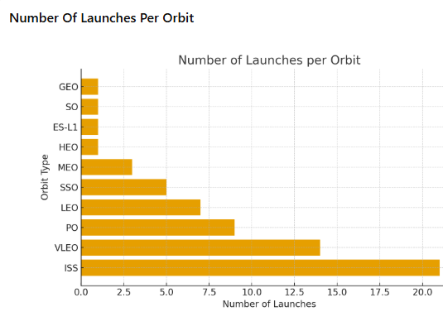
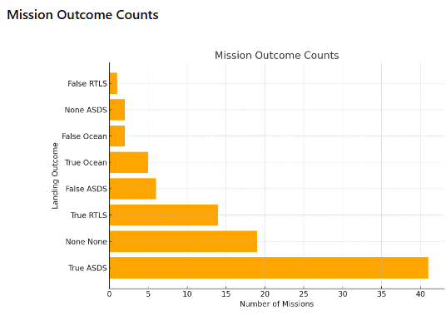
Data Wrangling
https://github.com/benz-health/Space-X-Space-Race-IBM-Capstone/blob/main/labs-jupyter-spacex-Data%20wrangling.ipynb
Used Pandas and Numpy on the SpaceX dataset that was collected to calculate number of launches from each site. Next, we calculated the success and volume of each launch based on orbit for the sites.

Slide 11
EDA with Data Visualization
Flight Number vs. Launch Site (Scatter Plot): Shows how mission experience varies by site and whether more flights lead to higher success.
Payload Mass vs. Launch Site (Scatter Plot): Compares payload size across sites to see which handle heavier missions and how mass relates to outcomes.
Success Rate by Orbit Type (Bar Chart): Highlights which orbit categories achieve the highest landing success rates.
Flight Number vs. Orbit Type (Scatter Plot): Shows how mission experience aligns with different orbit types and whether success improves over time.
Payload Mass vs. Orbit Type (Scatter Plot): Compares payload mass across orbits to reveal which support heavier missions and how that affects success.
Yearly Success Trend (Line Chart): Displays annual average success rates to show improvement in landing reliability over time.
https://github.com/benz-health/Space-X-Space-Race-IBM-Capstone/blob/main/edadataviz.ipynb

Slide 12
EDA with SQL
Task 1: Select distinct launch sites from the dataset.
Task 2: Retrieve the first five records where the launch site name begins with "CCA".
Task 3: Calculate the total payload mass carried by NASA (CRS) missions.
Task 4: Compute the average payload mass for booster version F9 v1.1.
Task 5: Find the earliest date when a successful ground-pad landing occurred.
Task 6: List boosters that successfully landed on a drone ship and carried payloads between 4000 and 6000 kg.
Task 7: Count the total number of successful and failed mission outcomes.
Task 8: Identify the booster versions that carried the maximum payload mass using a subquery.
Task 9: Display 2015 records showing month, failed drone-ship landings, booster version, and launch site.
Task 10: Rank landing outcomes between 2010-06-04 and 2017-03-20 in descending order by frequency.
https://github.com/benz-health/Space-X-Space-Race-IBM-Capstone/blob/main/jupyter-labs-eda-sql-coursera_sqllite.ipynb

Slide 13
Build an Interactive Map with Folium
Summarize what map objects such as markers, circles, lines, etc. you created and added to a folium map
Explain why you added those objects
Add the GitHub URL of your completed interactive map with Folium map, as an external reference and peer-review purpose

Slide 14
Build a Dashboard with Plotly Dash
Summarize what plots/graphs and interactions you have added to a dashboard
Explain why you added those plots and interactions
Add the GitHub URL of your completed Plotly Dash lab, as an external reference and peer-review purpose

Slide 15
Predictive Analysis (Classification)
Summarize how you built, evaluated, improved, and found the best performing classification model
You need present your model development process using key phrases and flowchart
Add the GitHub URL of your completed predictive analysis lab, as an external reference and peer-review purpose

Slide 16
Results
Exploratory data analysis results
Interactive analytics demo in screenshots
Predictive analysis results

Slide 17

Section 2

Slide 18
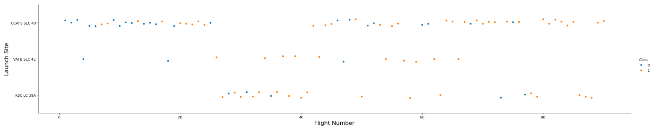
Flight Number vs. Launch Site
Flight numbers steadily increase across all launch sites, but most early missions occurred at CCAFS SLC-40, showing it was SpaceX’s primary testbed. As flights progress, both KSC LC-39A and VAFB SLC-4E appear more frequently, reflecting expansion into higher-performance or specialized launch pads. Across all sites, later flight numbers show a higher concentration of successful outcomes, suggesting that experience and improved technology boosted reliability regardless of location.

Slide 19
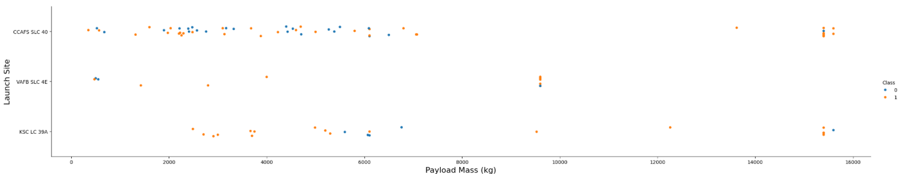
Payload vs. Launch Site
The highest-mass payloads (above ~10,000 kg) occur almost entirely at CCAFS SLC-40 and KSC LC-39A, and these heavy missions show noticeably fewer failed outcomes compared to mid-range payloads. Failures are more common in the light-to-mid payload range, suggesting mission complexity or other factors—not payload mass—drive early failures. Overall, heavier payload missions tend to cluster toward successful landings, indicating improved vehicle capability and operational confidence on high-stakes launches.

Slide 20
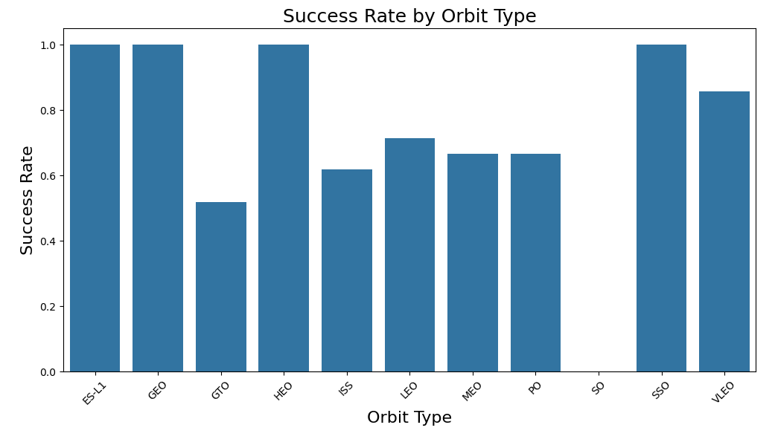
Success Rate vs. Orbit Type
Several orbit types—such as ES-L1, GEO, HEO, and SSO—show perfect success rates, indicating highly reliable missions in those profiles. GTO stands out with the lowest success rate, reflecting the added difficulty of high-energy transfers or more challenging mission conditions. Most other orbits, including LEO, ISS, and VLEO, show moderately high but not perfect reliability, suggesting that mission complexity varies but overall performance remains strong.

Slide 21
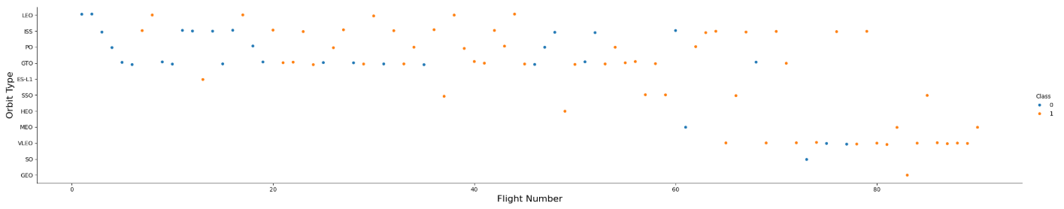
Flight Number vs. Orbit Type
Early flights are concentrated in LEO and ISS orbits, showing that SpaceX initially focused on lower-altitude and resupply missions. As flight numbers increase, missions diversify into more complex orbits like GTO, SSO, and HEO, indicating growing capability and mission variety. Success rates appear to improve across almost all orbit types over time, with later flights showing a higher proportion of successful landings regardless of orbit.

Slide 22
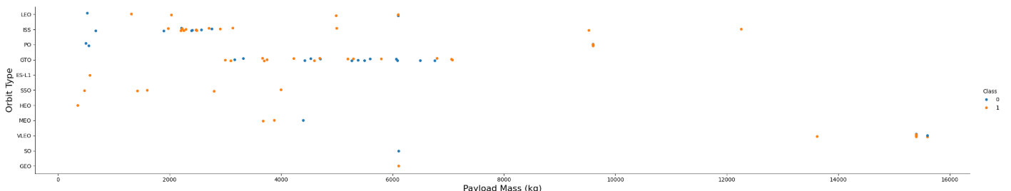
Payload vs. Orbit Type
Lower Earth orbits (LEO, ISS, PO) show a wide range of payload masses, reflecting their frequent use for varied mission types. Higher-energy or specialized orbits like GTO, SSO, and ES-L1 tend to carry heavier payloads, indicating these missions often leverage the full lift capacity of the Falcon family. Success appears consistent across most orbits even at higher payload masses, suggesting that orbit type—not payload weight—is the main source of mission complexity.

Slide 23
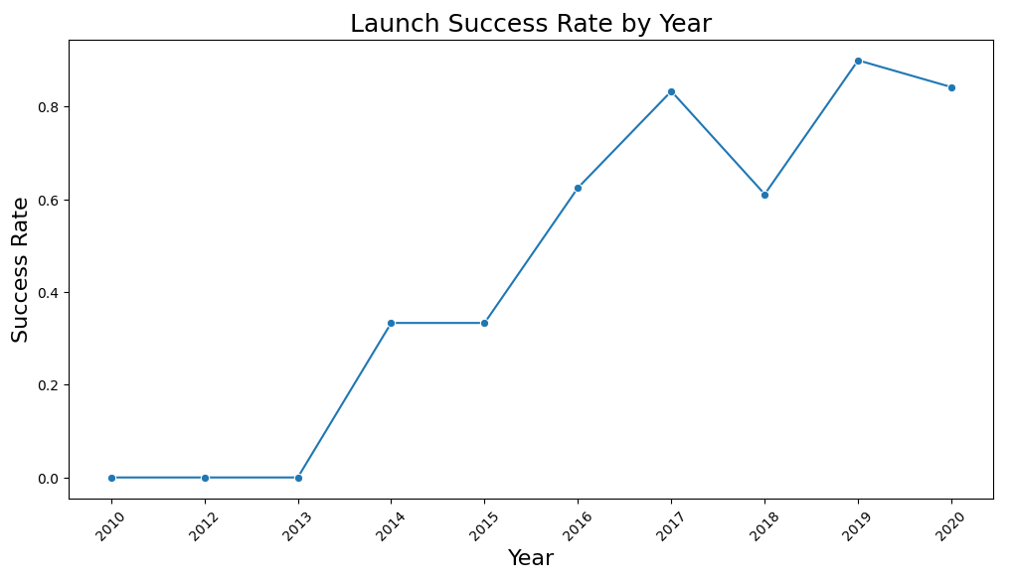
Launch Success Yearly Trend
SpaceX’s early missions show very low success rates, with reliability only beginning to improve meaningfully around 2014. After 2015, the success rate climbs sharply, reflecting major upgrades in booster design, landing technology, and operational experience. By 2019–2020, success stabilizes at consistently high levels, indicating that landing reliability has become a mature and repeatable capability.

Slide 24
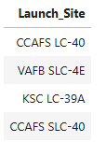
All Launch Site Names
Unique launch sites in the space mission queried below. 4 unique launch sites identified

Slide 25
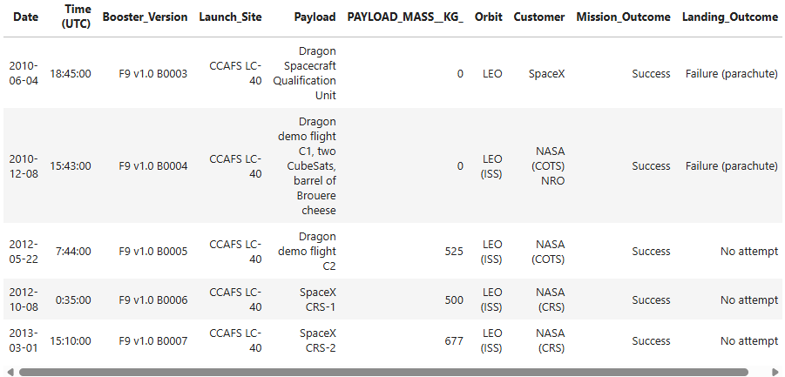
Launch Site Names Begin with 'CCA'
5 records where launch sites begin with `CCA`

Slide 26
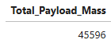
Total Payload Mass
Total payload carried by boosters from NASA

Slide 27
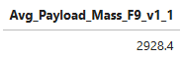
Average Payload Mass by F9 v1.1
The average payload mass carried by booster version F9 v1.1

Slide 28
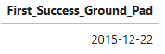
First Successful Ground Landing Date
Date of the first successful landing outcome on ground pad

Slide 29
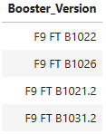
Successful Drone Ship Landing with Payload between 4000 and 6000
Booster which have successfully landed on drone ship and had payload mass greater than 4000 but less than 6000.

Slide 30
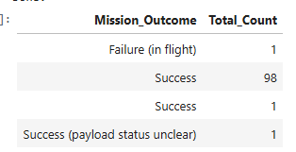
Total Number of Successful and Failure Mission Outcomes
Total number of successful and failure mission outcome.

Slide 31
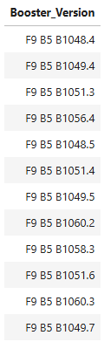
Boosters Carried Maximum Payload
List of Names of the boosters which have carried the maximum payload mass

Slide 32
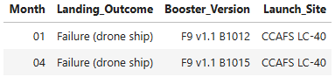
2015 Launch Records
Failed landing_outcomes in drone ship, their booster versions, and launch site names for in year 2015

Slide 33
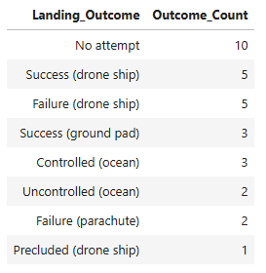
Rank Landing Outcomes Between 2010-06-04 and 2017-03-20
Rank the count of landing outcomes (such as Failure (drone ship) or Success (ground pad)) between the date 2010-06-04 and 2017-03-20, in descending order

Slide 34

Section 3

Slide 35
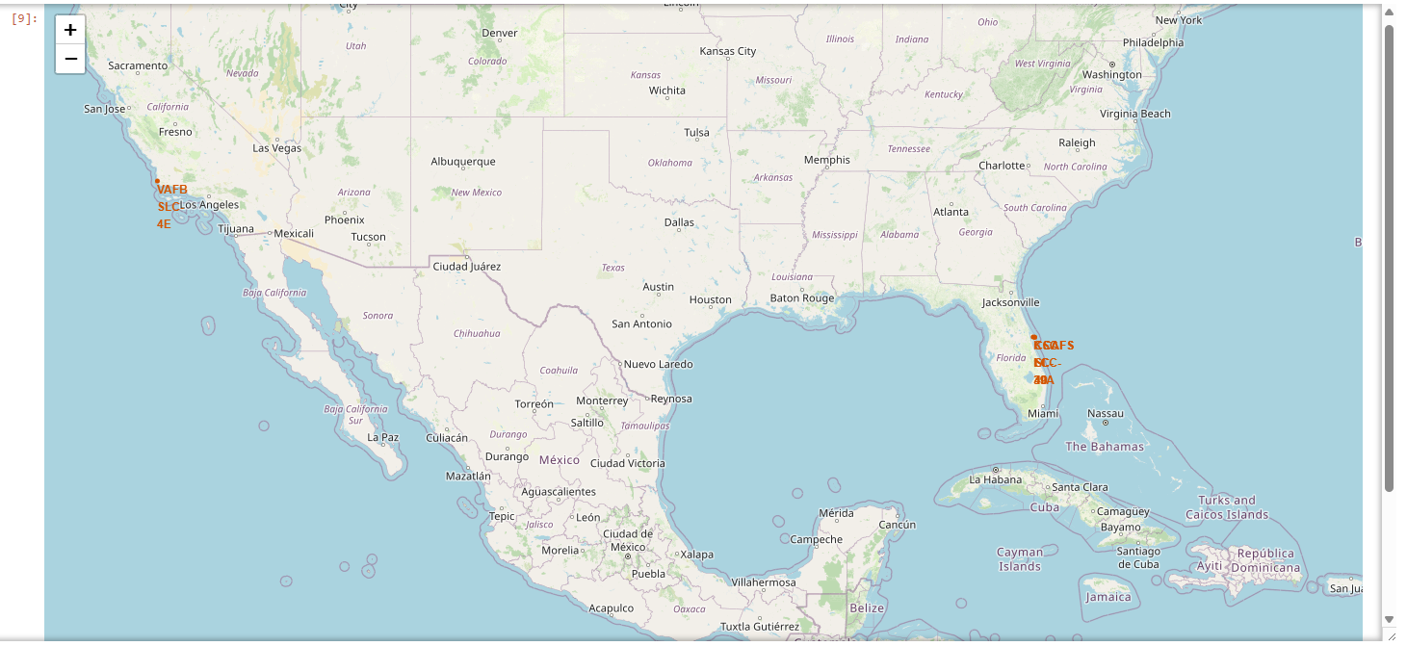
Global Map of SpaceX Launch Sites with Folium
Global map of all SpaceX launch sites. These are all in the USA near the coast and water.

Slide 36
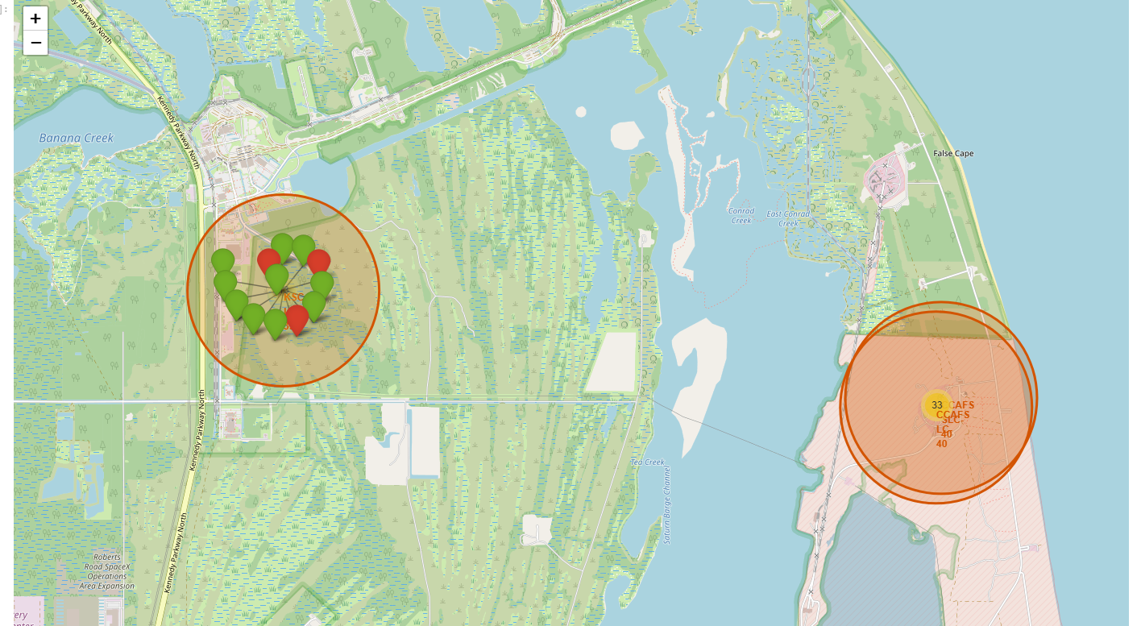
Success Outcomes per Site with Folium
Zoom in on each site and click into the markers to identify the Success and Non-Successful Outcomes.

Slide 37

Folium Map with Distances Marked to Landmarks
This shows the distance between the ocean ang the CCAFS SLC-40 launch site.

Slide 38

Section 4

Slide 39
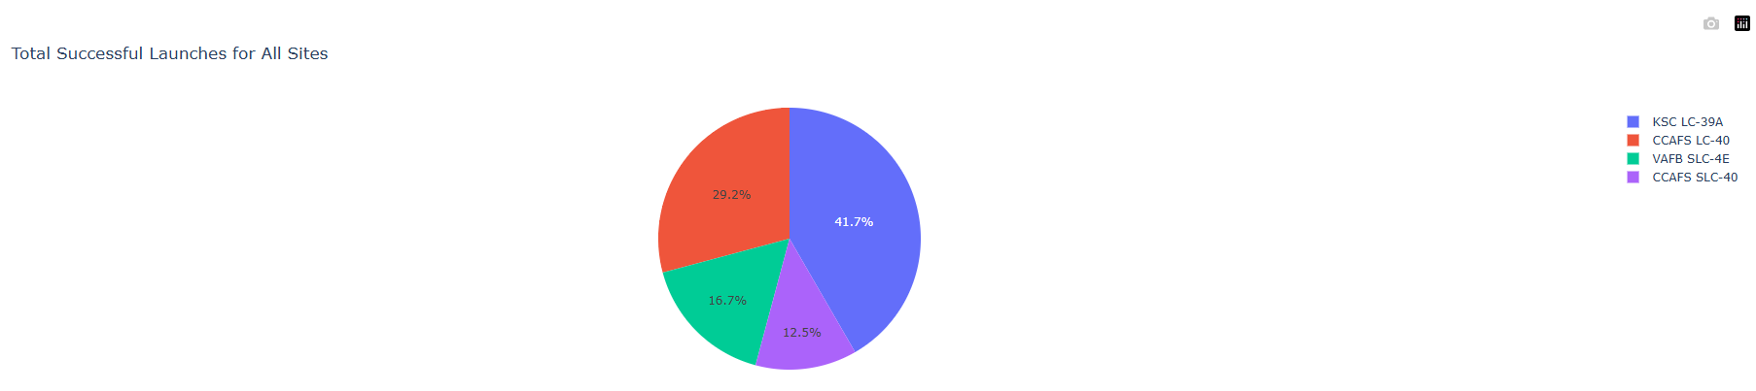
Dashboard: Launch Success for All Sites
The pie chart shows the distribution of all successful SpaceX launches across every launch site, making it easy to compare overall performance. KSC LC-39A and CCAFS LC-40 show the highest launch activity with the most successful missions, while VAFB SLC-4E and CCAFS SLC-40 display noticeably lower activity and fewer successes.

Slide 40
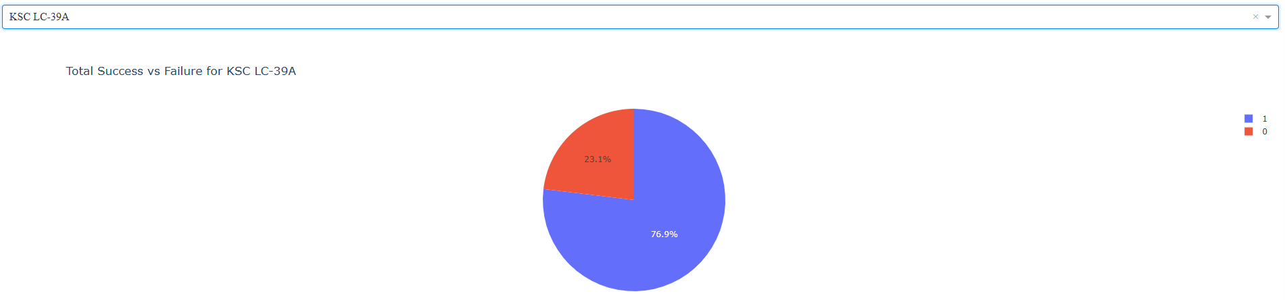
Dashboard: Most Successful Site
KSC LC-39A shows a strong performance profile, with the majority of its launches resulting in successful outcomes. Although failures do occur, they represent a much smaller share compared to its overall success rate, highlighting the site’s reliability.

Slide 41
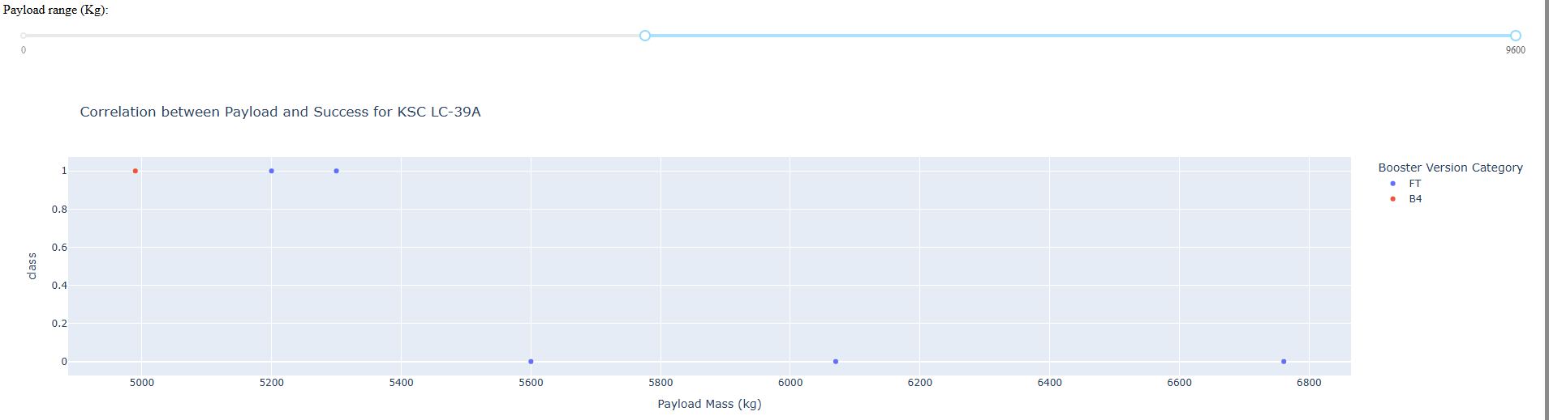
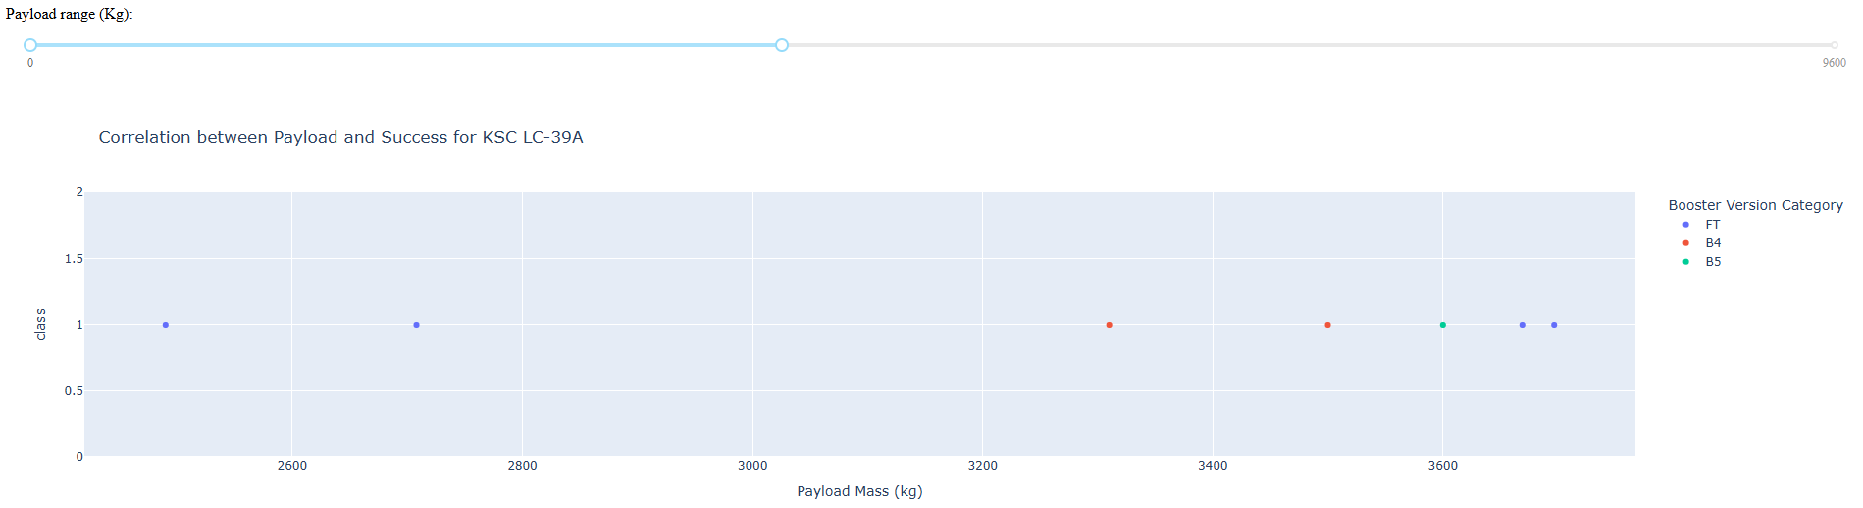
Correlation of Light vs Heavy Payload Success
The plots show that both light and heavy payloads achieve high success rates, with no strong negative correlation between payload mass and mission outcome. Booster versions appear consistently successful across ranges.

Slide 42

Section 5

Slide 43
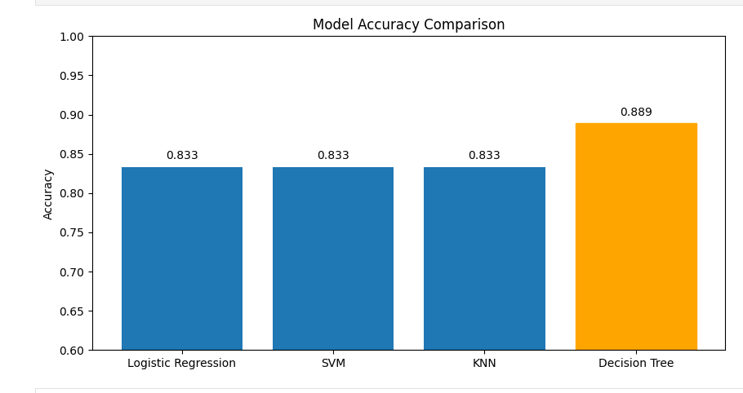
Classification Accuracy
Looks like the Decision Tree model has the highest accuracy in this case.

Slide 44
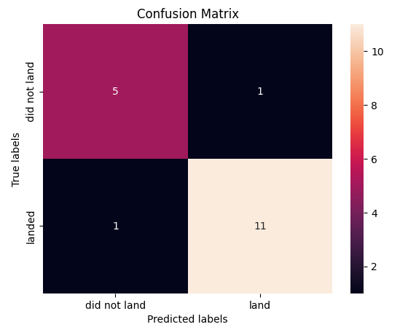
Confusion Matrix – Decision Tree
The decision tree captures non-linear relationships and feature interactions (like booster type + landing pad), allowing it to model more realistic landing patterns than logistic regression.
It produced fewer total errors—especially fewer false positives—leading to a more balanced and accurate classification.

Slide 45
Conclusions
Exploratory visualizations and SQL-driven analysis highlighted meaningful trends in launch performance and mission outcomes.
The dataset was thoroughly cleaned, standardized, and processed to ensure accuracy across all analytical steps.
Interactive dashboards built with Folium and Plotly Dash enabled intuitive exploration of geographic and operational insights.
Four classification models—Logistic Regression, SVM, Decision Tree, and KNN—were tuned using GridSearchCV and evaluated on a separate test set.
The Decision Tree delivered the highest accuracy, and future launch ventures can be benchmarked against this model to predict outcomes, assuming similar mission parameters and conditions.

Slide 46
Appendix
https://github.com/benz-health/Space-X-Space-Race-IBM-Capstone

Slide 47


